Slide 1


Disney
AI for Tax

Slide 2















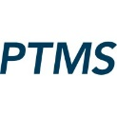

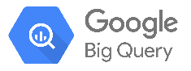



Current State Tax Technology Ecosystem
Key enterprise data source for use cases in production
Apps
AI-powered apps (copilots, knowledge assistants) and existing Tax applications used by Disney Tax teams.
Applications
AI Apps
Tax Apps
Data Hub & Data Flow, Tax Provision, Common Entities
Checkpoint
DisneyGPT
Digital Gateway
Models
FMs, LLMs, other AI models incl tools & capabilities to tune and train models
Models
TAC (Machine learning algorithm within contributions database)
Enterprise IAM
Compute
Hardware and software resources train, tune, run, and serve models
Compute
Tax has the option to create their own cloud tenant in Azure – don’t have anything deployed in Azure today
Content / Data
Data sources and platforms frequently used by Disney Tax teams and needed to develop AI use cases.
Data Sources / Platforms
fshelp
ControlPoint
Concur
Olaf
EDP
GTP
OSA
Data Hub & Data Flow
Data Hub & Data Flow, Tax Provision, Common Entities
Olaf, Cognos, and OSA (getting an API later in 2025) are not currently accessible by API

